Slide 1
BIYA GALLERY · THE THIRD ART
Surah Yaseen
THE HEART OF THE QUR'AN
Seventy-One Handmade Folios
MASTER ACQUISITION PITCH
Prepared for National Assad · Museum & Exhibition Partners
One verse, one frame - a complete surah, read wall to wall.
Physical display · Digital previews · Investment value
BIYA GALLERY · LAHORE · 2026

Slide 2
BIYA GALLERY
PART 01
Contents
Master Pitch - 71 Folios
Title & Vision
03
The title, the project, why it is a masterpiece, the founder, the vision
PART 02
The Collection
09
Seventy-one original
Thread Art panels of the
Heart of the Quran cycle,
framed for a national home.
Complete overview, process, materials, content architecture, exhibition concept
PART 03
The Seventy-One Folios
17
Every folio on its own slide - image attached, verse verified, Arabic and translation
PART 04
Acquisition
89
BIYA GALLERY · ART & CRAFT · LAHORE
Investment value, acquisition options, inquiries
BIYA GALLERY · ART & CRAFT
Original art, Thread Art, poetry and craft from Lahore
COLLECTION · SERVICES · POETRY

Slide 3
PART 01
Title & Vision
What this collection is, why it is a masterpiece, and who makes it
BIYA GALLERY · ART & CRAFT
Original art, Thread Art, poetry and craft from Lahore
COLLECTION · SERVICES · POETRY

Slide 4
TITLE & VISION · I.1
The Title & the Vision
Surah Yaseen - The Heart of the Quran
Seventy-one handmade folios: a complete Quranic verse cycle, one verse per frame, executed in the Third Art thread practice and presented for national acquisition.
The vision is simple and singular: that a surah called the heart of the Quran should have a national home - wall to wall, folio to folio, readable the way it is recited, and preserved in archive-grade form for the next hundred years.
Each folio is an original work - not a print. The collection is complete, numbered, and catalogued; it can hang as one composition or as a decade of exhibitions.
THE COLLECTION IN ONE LINE
FOLIO 01 - 71
one verse · one frame · one original
69 photographed · 2 reserved
verses of Surah Ar-Rahman (55)
the refrain returns 31 times as a folio of its own
BIYA GALLERY · ART & CRAFT
Original art, Thread Art, poetry and craft from Lahore
COLLECTION · SERVICES · POETRY

Slide 5
THE PROJECT · I.2
Introduction - The Project
What this is
A complete, hand-executed Quranic art collection: seventy-one original panels, each painting one verse from the Heart of the Quran cycle, framed in the gallery's signature gold-edge presentation and photographed at archival resolution.
What makes it different
It is not a print run and not a reproduction. Every panel is worked by hand in the Third Art practice - original art, Thread Art, poetry and craft from Lahore - and every verse is verified against the Uthmani codex and set with its English rendering on the folio record, so the collection stands as both an artwork and a readable surah.
What this deck is
The master acquisition pitch for national museum and exhibition partners: the complete collection presented folio by folio (71 slides, every image attached), with the physical display strategy, the digital preview system, and the investment case for taking the collection into a national home.
BIYA GALLERY · ART & CRAFT
Original art, Thread Art, poetry and craft from Lahore
COLLECTION · SERVICES · POETRY

Slide 6
THE PROJECT · I.3
Why It Is a Masterpiece
VERSE AS IMAGE
ONE HAND, ONE CHAPTER
THE REFRAIN AS HEARTBEAT
UNREPEATABLE BY DESIGN
Each panel is a single verse made into a picture: calligraphy, ground, and field composed for that verse alone. The collection cannot be reduced to decoration - it is a reading.
Seventy-one panels, one artist, one unbroken season of work. The uniformity of hand across the cycle is what makes it a single composition rather than a set.
The surah's question - 'Then which of the favours of your Lord will ye deny?' - returns 31 times as a folio of its own: a rhythm built into the architecture of the wall.
Handmade originals cannot be re-run. Once acquired and installed, the cycle exists in exactly one place on earth. That scarcity is the basis of its investment value.
BIYA GALLERY · ART & CRAFT
Original art, Thread Art, poetry and craft from Lahore
COLLECTION · SERVICES · POETRY

Slide 7
THE FOUNDER · I.4
Biya Jee - First Lady of Third Art
B
Biya Jee founded Biya Gallery Art & Craft in Lahore and named its practice the Third Art - the joining of original art, Thread Art, poetry and craft into one working discipline. The gallery's archive describes her as the First Lady of Third Art, a practice held since 1985.
The 71-folio Heart of the Quran cycle is her signature work: a complete surah taken verse by verse and executed by hand over a single unbroken campaign, then presented as one composition. It is the first complete handmade Quranic verse cycle of its kind to enter the market.
Every folio in this deck carries her hand. The collection's value is inseparable from its author: one artist, one chapter, one lifetime practice.
THE THIRD ART
founded & practised in Lahore
BIYA JEE
Founder & Artist, Biya Gallery Art & Craft
PRACTICE SINCE 1985
BIYA GALLERY · ART & CRAFT
Original art, Thread Art, poetry and craft from Lahore
COLLECTION · SERVICES · POETRY

Slide 8
THE PROJECT · I.5
Project Vision
Preserve · Legacy · Bridge
Preserve
Archive-grade execution, 4K masters and 1.5x print sets for every folio, so the collection survives as an object and as a record.
Legacy
A national home for a complete surah in handmade form - a permanent installation that becomes the city's reading of the Heart of the Quran.
Bridge
A bridge between the recited word and the seen image: visitors read wall to wall while the surah plays, then carry the digital preview with them.
WHAT A NATIONAL PARTNER RECEIVES
71 numbered originals with catalogue record
4K + 1.5x print masters of every folio
Verified verse record (Uthmani codex + English)
Exhibition system: wall plan, lighting, digital previews
Touring capability from day one
BIYA GALLERY · ART & CRAFT
Original art, Thread Art, poetry and craft from Lahore
COLLECTION · SERVICES · POETRY

Slide 9
PART 02
The Collection
How it was made, what it is made of, how it is organised, and how it hangs
BIYA GALLERY · ART & CRAFT
Original art, Thread Art, poetry and craft from Lahore
COLLECTION · SERVICES · POETRY

Slide 10
THE COLLECTION · II.1
Complete Collection Overview
71
69 + 2
55
FOLIOS IN THE CYCLE
PHOTOGRAPHED + RESERVED
SURAH AR-RAHMAN
one verse per frame, F01 - F71
two frames awaiting final photography
Medinan surah · 78 verses · 'The Beneficent'
31
10
4K
REFRAIN FOLIOS
CHAPTERS
WORKING MASTERS
the surah's question, each as its own panel
the collection reads in ten movements
1613 x 1314 px per folio · 1.5x print sets
Verse integrity: every folio is labelled with the actual verse it depicts, transcribed from the panel and verified against the Uthmani codex (alquran.cloud, 19 Sep 2026). Refrain panels carry the refrain; 18 refrain panels are flagged 'verify' in the inventory for final numbering against the physical frame before release.
BIYA GALLERY · ART & CRAFT
Original art, Thread Art, poetry and craft from Lahore
COLLECTION · SERVICES · POETRY

Slide 11
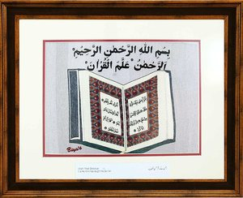
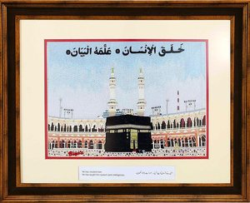
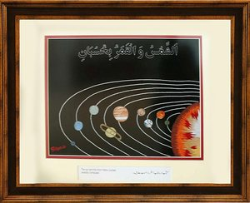
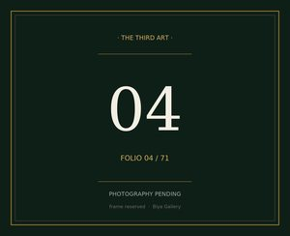
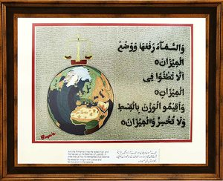
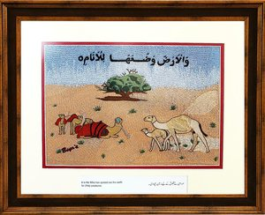
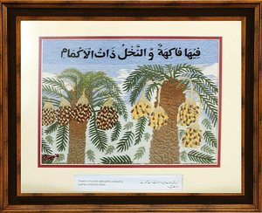
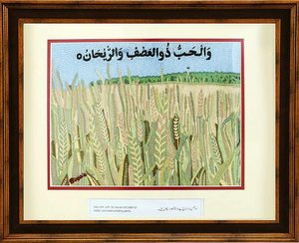
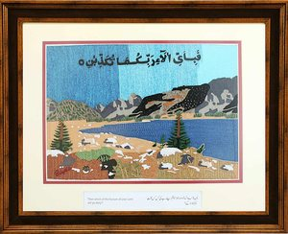
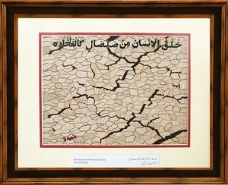
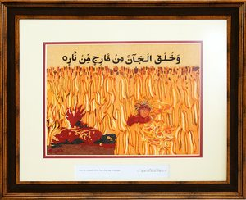
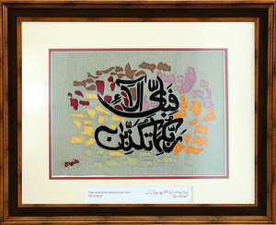
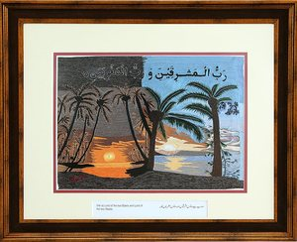
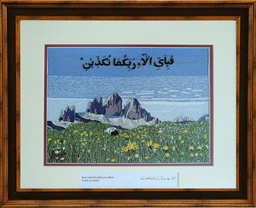
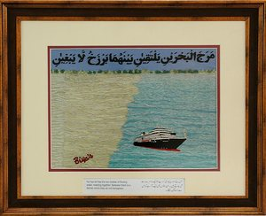
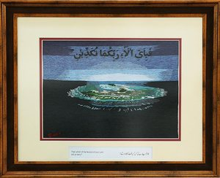
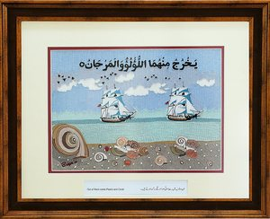
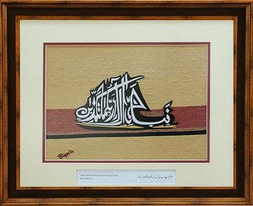
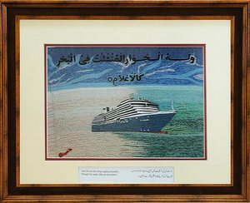
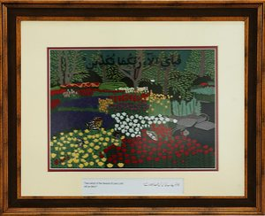
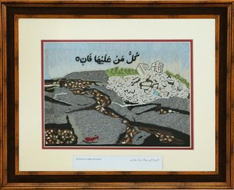
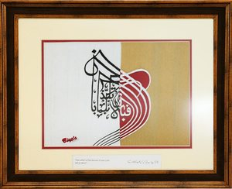
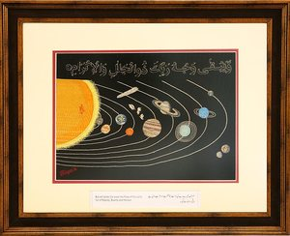
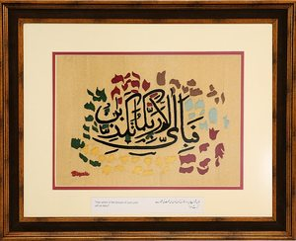
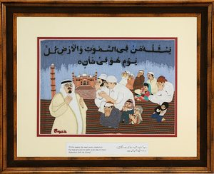
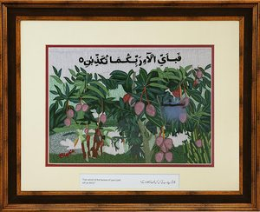
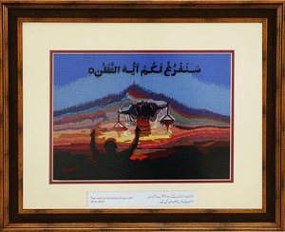
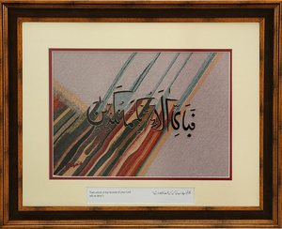
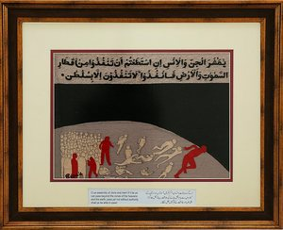
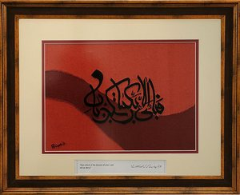
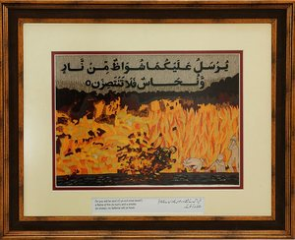
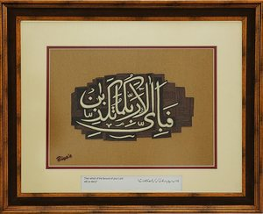
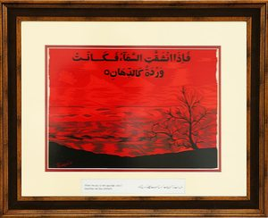
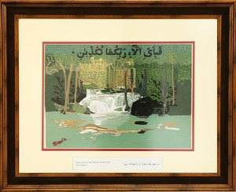
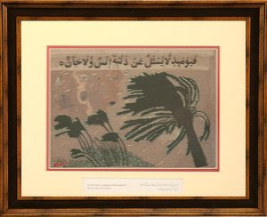
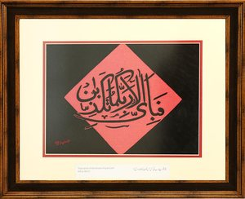
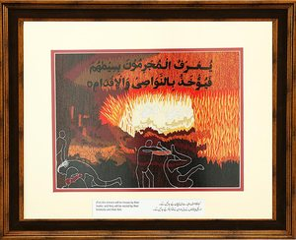
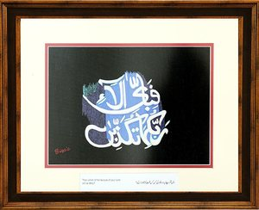
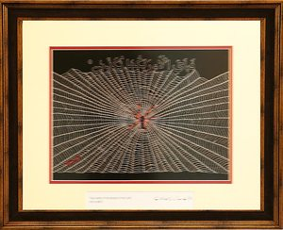
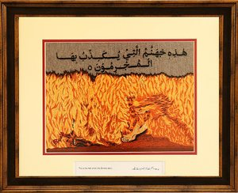
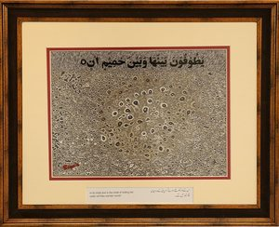
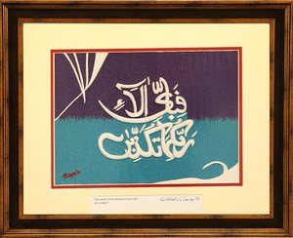
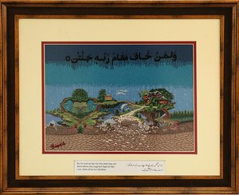
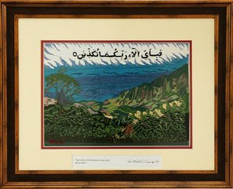
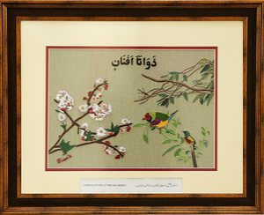
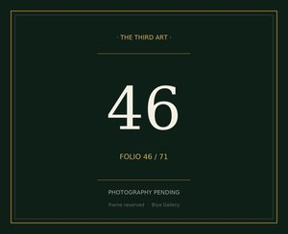
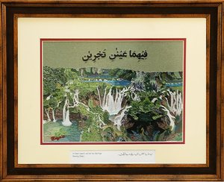
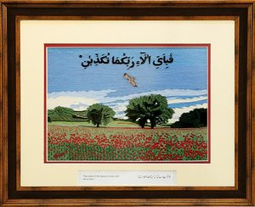
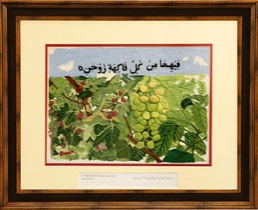
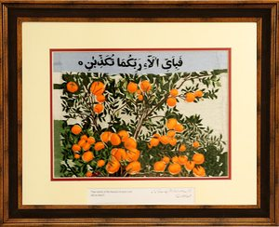





















THE COLLECTION · 71 FOLIOS
Seventy-one
folios, in display order
01
02
03
04
05
06
07
08
09
10
11
12
13
14
15
16
17
18
19
20
Read left to right, top to bottom. Gold-bordered numbers are the folio catalogue numbers.
Frames 04 and 46 are reserved - photography pending; every other slide in this deck carries its image.
21
22
23
24
25
26
27
28
29
30
31
32
33
34
35
36
37
38
39
40
41
42
43
44
45
46
47
48
49
50
51
52
53
54
55
56
57
58
59
60
61
62
63
64
65
66
67
68
69
70
BIYA GALLERY · ART & CRAFT
71
BIYA GALLERY · ART & CRAFT
Original art, Thread Art, poetry and craft from Lahore
COLLECTION · SERVICES · POETRY

Slide 12
THE COLLECTION · II.2
The Handmade Process & Craftsmanship
01
02
03
04
05
THE VERSE
GROUND & PIGMENT
THREAD ART
GOLD & FINISH
FRAME & RECORD
The verse is verified against the Uthmani codex and set into the panel's composition - calligraphy, ground and field planned for that verse alone.
The panel ground is built up by hand; pigments are ground and mixed for the work, layered rather than printed.
The Third Art thread practice: worked by hand across the field, the texture that carries light differently at every angle.
Gold detailing and the final hand finish; the panel is rested and inspected before it is framed.
Gold-edge frame on cream; photographed, polished, and saved at 4K working master and 1.5x print resolution.
→
→
→
→
Many weeks of handwork per folio, one artist, one unbroken campaign across all 71. No machine reproduction exists for any panel in the cycle.
BIYA GALLERY · ART & CRAFT
Original art, Thread Art, poetry and craft from Lahore
COLLECTION · SERVICES · POETRY

Slide 13
THE COLLECTION · II.3
Materials & Techniques
Materials
· Hand-ground pigments and natural colour on prepared panel ground
· Thread work in the Third Art practice - the gallery's signature medium
· Gold detailing in the gold-edge presentation
· Archival mounting, cream presentation, solid frame
Techniques
· Verse composition: each panel is drawn for its single verse
· Layered ground and texture, worked to hold raking light
· Hand finishing and inspection, panel by panel
WHAT THE HAND LEAVES BEHIND
No two panels share a machine pass. The thread field changes under moving light; the gold reads at gallery distance; the ground keeps its depth up close.
This is why the cycle is described as a masterpiece rather than a series: the hand is visible in every folio, and the uniformity of that hand across 71 verses is the work itself.
BIYA GALLERY · ART & CRAFT
Original art, Thread Art, poetry and craft from Lahore
COLLECTION · SERVICES · POETRY

Slide 14
THE COLLECTION · II.4
Material Excellence & Specifications
WORKING MASTER
1613 x 1314 px per folio (4K-class archival scan)
PRINT SET
1.5x masters - 2420 x 1971 px - for museum-scale reproduction
PANEL RATIO
4 : 3.3 - the framed presentation ratio, uniform across all 71
PRESENTATION
Gold-edge frame on cream; uniform sight-line across the wall
LIGHTING
Warm 3000K, even grazing; gold detail reads at 3m
VERBATIM RECORD
Uthmani Arabic + English rendering per folio, codex-verified
CATALOGUE
F01 - F71 catalogue numbers on every folio and plate
CONDITION
69 photographed and archived · 2 reserved for final photography
All figures are the production standard of the cycle; per-folio condition reports accompany any acquisition.
BIYA GALLERY · ART & CRAFT
Original art, Thread Art, poetry and craft from Lahore
COLLECTION · SERVICES · POETRY

Slide 15
THE COLLECTION · II.5
Content Architecture
How the collection is organised
· Catalogue order F01 - F71, the order in which the surah reads on the wall
· Ten chapters: the natural movements of the surah, from the Beneficent who teaches to the blessing that closes
· 40 verse folios + 31 refrain folios - the refrain is a structural element, not a gap
· Each folio record: catalogue number, title, verse reference, Uthmani Arabic, English rendering, verification status
· Release checklist: 18 refrain panels flagged 'verify' for final verse numbering against the physical frame before public release
FOLIO 47 / 71
Two Springs Flowing
In them (each) will be two Springs flowing (free).
→
فِيهِمَا عَيْنَانِ تَجْرِيَانِ
THE PANEL
image attached on every folio slide
SURAH AR-RAHMAN (55)
VERSE 55:50 · VERIFIED
BIYA GALLERY · ART & CRAFT
Original art, Thread Art, poetry and craft from Lahore
COLLECTION · SERVICES · POETRY

Slide 16
THE COLLECTION · II.6
Exhibition Concept
One room, one wall, one reading - physical display, digital previews and storytelling as a single system.
PHYSICAL DISPLAY
DIGITAL PREVIEWS
STORYTELLING
All 71 folios hang in catalogue order along the long wall in three courses. Evergreen walls, warm 3000K grazing light, a single reading line. Chapter markers at the ten movement boundaries; the wall opens and closes on the refrain.
Each wall label carries a QR: high-resolution folio preview, the verse in Uthmani script and English, and the recitation of that verse. The room extends into the pocket - visitors carry the collection home.
An audio line follows the wall: the surah recites itself as the visitor walks, so the eye reads the image while the ear reads the word. The refrain - 31 times on the wall - is the heartbeat of the room.
WALL PLAN - 71 FRAMES IN SURAH ORDER
cream = verse folio · gold = refrain folio
three courses; refrain panels mark the rhythm of the reading
BIYA GALLERY · ART & CRAFT
Original art, Thread Art, poetry and craft from Lahore
COLLECTION · SERVICES · POETRY

Slide 17
PART 03
The Seventy-One Folios
Every folio on its own slide - image attached, verse verified, Arabic and English on the record
BIYA GALLERY · ART & CRAFT
Original art, Thread Art, poetry and craft from Lahore
COLLECTION · SERVICES · POETRY

Slide 18

THE THIRD ART · FOLIO 01 / 71
The Beneficent Teaches
"(Allah) Most Gracious! It is He Who has taught the Qur'an."
ٱلرَّحْمَٰنُ عَلَّمَ ٱلْقُرْءَانَ
01
SURAH AR-RAHMAN (55) · MEDINAN · JUZ 27 · PAGES 531-534
VERSE 55:01–02 · VERIFIED, UTHMANI CODEX
BIYA GALLERY · ART & CRAFT
Original art, Thread Art, poetry and craft from Lahore
COLLECTION · SERVICES · POETRY

Slide 19

THE THIRD ART · FOLIO 02 / 71
Created Man, Taught Speech
"He has created man: He has taught him speech (and intelligence)."
خَلَقَ ٱلْإِنسَٰنَ عَلَّمَهُ ٱلْبَيَانَ
02
SURAH AR-RAHMAN (55) · MEDINAN · JUZ 27 · PAGES 531-534
VERSE 55:03–04 · VERIFIED, UTHMANI CODEX
BIYA GALLERY · ART & CRAFT
Original art, Thread Art, poetry and craft from Lahore
COLLECTION · SERVICES · POETRY

Slide 20

THE THIRD ART · FOLIO 03 / 71
The Computed Course
"The sun and the moon follow courses (exactly) computed."
ٱلشَّمْسُ وَٱلْقَمَرُ بِحُسْبَانٍۢ
03
SURAH AR-RAHMAN (55) · MEDINAN · JUZ 27 · PAGES 531-534
VERSE 55:05 · VERIFIED, UTHMANI CODEX
BIYA GALLERY · ART & CRAFT
Original art, Thread Art, poetry and craft from Lahore
COLLECTION · SERVICES · POETRY

Slide 21

THE THIRD ART · FOLIO 04 / 71
Frame Reserved
"Photography pending - frame reserved."
Arabic text to be entered from the physical frame.
04
FRAME RESERVED · PHOTOGRAPHY PENDING
VERSE TO BE ENTERED FROM FRAME
BIYA GALLERY · ART & CRAFT
Original art, Thread Art, poetry and craft from Lahore
COLLECTION · SERVICES · POETRY

Slide 22

THE THIRD ART · FOLIO 05 / 71
The Raised Firmament, the Balance
"And the Firmament has He raised high, and He has set up the Balance (of Justice), in order that ye may not transgress (due) balance."
وَٱلسَّمَآءَ رَفَعَهَا وَوَضَعَ ٱلْمِيزَانَ أَلَّا تَطْغَوْا۟ فِى ٱلْمِيزَانِ وَأَقِيمُوا۟ ٱلْوَزْنَ بِٱلْقِسْطِ وَلَا تُخْسِرُوا۟ ٱلْمِيزَانَ
05
SURAH AR-RAHMAN (55) · MEDINAN · JUZ 27 · PAGES 531-534
VERSE 55:07–09 · VERIFIED, UTHMANI CODEX
BIYA GALLERY · ART & CRAFT
Original art, Thread Art, poetry and craft from Lahore
COLLECTION · SERVICES · POETRY

Slide 23

THE THIRD ART · FOLIO 06 / 71
The Earth Spread Out
"It is He Who has spread out the earth for (His) creatures."
وَٱلْأَرْضَ وَضَعَهَا لِلْأَنَامِ
06
SURAH AR-RAHMAN (55) · MEDINAN · JUZ 27 · PAGES 531-534
VERSE 55:10 · VERIFIED, UTHMANI CODEX
BIYA GALLERY · ART & CRAFT
Original art, Thread Art, poetry and craft from Lahore
COLLECTION · SERVICES · POETRY

Slide 24

THE THIRD ART · FOLIO 07 / 71
Fruit and Sheathed Palms
"Therein is fruit and date-palms, producing spathes (enclosing dates)."
فِيهَا فَٰكِهَةٌۭ وَٱلنَّخْلُ ذَاتُ ٱلْأَكْمَامِ
07
SURAH AR-RAHMAN (55) · MEDINAN · JUZ 27 · PAGES 531-534
VERSE 55:11 · VERIFIED, UTHMANI CODEX
BIYA GALLERY · ART & CRAFT
Original art, Thread Art, poetry and craft from Lahore
COLLECTION · SERVICES · POETRY

Slide 25

THE THIRD ART · FOLIO 08 / 71
Husked Grain, Scented Herb
"Also corn, with (its) leaves and stalk for fodder, and sweet-smelling plants."
وَٱلْحَبُّ ذُو ٱلْعَصْفِ وَٱلرَّيْحَانُ
08
SURAH AR-RAHMAN (55) · MEDINAN · JUZ 27 · PAGES 531-534
VERSE 55:12 · VERIFIED, UTHMANI CODEX
BIYA GALLERY · ART & CRAFT
Original art, Thread Art, poetry and craft from Lahore
COLLECTION · SERVICES · POETRY

Slide 26

THE THIRD ART · FOLIO 09 / 71
The Recurring Question
"Then which of the favours of your Lord will ye deny?"
فَبِأَىِّ ءَالَآءِ رَبِّكُمَا تُكَذِّبَانِ
09
THE RECURRENT REFRAIN OF THE SURAH
VERSE NUMBER - VERIFIED
BIYA GALLERY · ART & CRAFT
Original art, Thread Art, poetry and craft from Lahore
COLLECTION · SERVICES · POETRY

Slide 27

THE THIRD ART · FOLIO 10 / 71
Man of Sounding Clay
"He created man from sounding clay like unto pottery."
خَلَقَ ٱلْإِنسَٰنَ مِن صَلْصَٰلٍۢ كَٱلْفَخَّارِ
10
SURAH AR-RAHMAN (55) · MEDINAN · JUZ 27 · PAGES 531-534
VERSE 55:14 · VERIFIED, UTHMANI CODEX
BIYA GALLERY · ART & CRAFT
Original art, Thread Art, poetry and craft from Lahore
COLLECTION · SERVICES · POETRY

Slide 28

THE THIRD ART · FOLIO 11 / 71
Jinn of Smokeless Fire
"And He created Jinns from fire free of smoke."
وَخَلَقَ ٱلْجَآنَّ مِن مَّارِجٍۢ مِّن نَّارٍۢ
11
SURAH AR-RAHMAN (55) · MEDINAN · JUZ 27 · PAGES 531-534
VERSE 55:15 · VERIFIED, UTHMANI CODEX
BIYA GALLERY · ART & CRAFT
Original art, Thread Art, poetry and craft from Lahore
COLLECTION · SERVICES · POETRY

Slide 29

THE THIRD ART · FOLIO 12 / 71
Soon Shall We Settle You
"Soon shall We settle your affairs, O both ye worlds!"
سَنَفْرُغُ لَكُمْ أَيُّهَ ٱلثَّقَلَانِ
12
SURAH AR-RAHMAN (55) · MEDINAN · JUZ 27 · PAGES 531-534
VERSE 55:31 · VERIFIED, UTHMANI CODEX
BIYA GALLERY · ART & CRAFT
Original art, Thread Art, poetry and craft from Lahore
COLLECTION · SERVICES · POETRY

Slide 30

THE THIRD ART · FOLIO 13 / 71
Lord of the Two Easts
"(He is) Lord of the two Easts and Lord of the two Wests."
رَبُّ ٱلْمَشْرِقَيْنِ وَرَبُّ ٱلْمَغْرِبَيْنِ
13
SURAH AR-RAHMAN (55) · MEDINAN · JUZ 27 · PAGES 531-534
VERSE 55:17 · VERIFIED, UTHMANI CODEX
BIYA GALLERY · ART & CRAFT
Original art, Thread Art, poetry and craft from Lahore
COLLECTION · SERVICES · POETRY

Slide 31

THE THIRD ART · FOLIO 14 / 71
The Recurring Question
"Then which of the favours of your Lord will ye deny?"
فَبِأَىِّ ءَالَآءِ رَبِّكُمَا تُكَذِّبَانِ
14
THE RECURRENT REFRAIN OF THE SURAH
VERSE NUMBER - VERIFIED
BIYA GALLERY · ART & CRAFT
Original art, Thread Art, poetry and craft from Lahore
COLLECTION · SERVICES · POETRY

Slide 32

THE THIRD ART · FOLIO 15 / 71
The Two Seas
"He has let free the two bodies of flowing water, meeting together: between them is a barrier which they do not transgress."
مَرَجَ ٱلْبَحْرَيْنِ يَلْتَقِيَانِ بَيْنَهُمَا بَرْزَخٌۭ لَّا يَبْغِيَانِ
15
SURAH AR-RAHMAN (55) · MEDINAN · JUZ 27 · PAGES 531-534
VERSE 55:19–20 · VERIFIED, UTHMANI CODEX
BIYA GALLERY · ART & CRAFT
Original art, Thread Art, poetry and craft from Lahore
COLLECTION · SERVICES · POETRY

Slide 33

THE THIRD ART · FOLIO 16 / 71
The Recurring Question
"Then which of the favours of your Lord will ye deny?"
فَبِأَىِّ ءَالَآءِ رَبِّكُمَا تُكَذِّبَانِ
16
THE RECURRENT REFRAIN OF THE SURAH
VERSE NUMBER - VERIFIED
BIYA GALLERY · ART & CRAFT
Original art, Thread Art, poetry and craft from Lahore
COLLECTION · SERVICES · POETRY

Slide 34

THE THIRD ART · FOLIO 17 / 71
Pearl and Coral
"Out of them come Pearls and Coral."
يَخْرُجُ مِنْهُمَا ٱللُّؤْلُؤُ وَٱلْمَرْجَانُ
17
SURAH AR-RAHMAN (55) · MEDINAN · JUZ 27 · PAGES 531-534
VERSE 55:22 · VERIFIED, UTHMANI CODEX
BIYA GALLERY · ART & CRAFT
Original art, Thread Art, poetry and craft from Lahore
COLLECTION · SERVICES · POETRY

Slide 35

THE THIRD ART · FOLIO 18 / 71
The Recurring Question
"Then which of the favours of your Lord will ye deny?"
فَبِأَىِّ ءَالَآءِ رَبِّكُمَا تُكَذِّبَانِ
18
THE RECURRENT REFRAIN OF THE SURAH
VERSE NUMBER - VERIFIED
BIYA GALLERY · ART & CRAFT
Original art, Thread Art, poetry and craft from Lahore
COLLECTION · SERVICES · POETRY

Slide 36

THE THIRD ART · FOLIO 19 / 71
Ships Like Banners
"And His are the Ships sailing smoothly through the seas, lofty as mountains."
وَلَهُ ٱلْجَوَارِ ٱلْمُنشَـَٔاتُ فِى ٱلْبَحْرِ كَٱلْأَعْلَٰمِ
19
SURAH AR-RAHMAN (55) · MEDINAN · JUZ 27 · PAGES 531-534
VERSE 55:24 · VERIFIED, UTHMANI CODEX
BIYA GALLERY · ART & CRAFT
Original art, Thread Art, poetry and craft from Lahore
COLLECTION · SERVICES · POETRY

Slide 37

THE THIRD ART · FOLIO 20 / 71
The Recurring Question
"Then which of the favours of your Lord will ye deny?"
فَبِأَىِّ ءَالَآءِ رَبِّكُمَا تُكَذِّبَانِ
20
THE RECURRENT REFRAIN OF THE SURAH
VERSE NUMBER - VERIFIED
BIYA GALLERY · ART & CRAFT
Original art, Thread Art, poetry and craft from Lahore
COLLECTION · SERVICES · POETRY

Slide 38

THE THIRD ART · FOLIO 21 / 71
All Shall Pass Away
"All that is on earth will perish."
كُلُّ مَنْ عَلَيْهَا فَانٍۢ
21
SURAH AR-RAHMAN (55) · MEDINAN · JUZ 27 · PAGES 531-534
VERSE 55:26 · VERIFIED, UTHMANI CODEX
BIYA GALLERY · ART & CRAFT
Original art, Thread Art, poetry and craft from Lahore
COLLECTION · SERVICES · POETRY

Slide 39

THE THIRD ART · FOLIO 22 / 71
The Recurring Question
"Then which of the favours of your Lord will ye deny?"
فَبِأَىِّ ءَالَآءِ رَبِّكُمَا تُكَذِّبَانِ
22
THE RECURRENT REFRAIN OF THE SURAH
VERSE NUMBER - PENDING VERIFICATION
BIYA GALLERY · ART & CRAFT
Original art, Thread Art, poetry and craft from Lahore
COLLECTION · SERVICES · POETRY

Slide 40

THE THIRD ART · FOLIO 23 / 71
The Face of Thy Lord
"But will abide (for ever) the Face of thy Lord, full of Majesty, Bounty and Honour."
وَيَبْقَىٰ وَجْهُ رَبِّكَ ذُو ٱلْجَلَٰلِ وَٱلْإِكْرَامِ
23
SURAH AR-RAHMAN (55) · MEDINAN · JUZ 27 · PAGES 531-534
VERSE 55:27 · VERIFIED, UTHMANI CODEX
BIYA GALLERY · ART & CRAFT
Original art, Thread Art, poetry and craft from Lahore
COLLECTION · SERVICES · POETRY

Slide 41

THE THIRD ART · FOLIO 24 / 71
The Recurring Question
"Then which of the favours of your Lord will ye deny?"
فَبِأَىِّ ءَالَآءِ رَبِّكُمَا تُكَذِّبَانِ
24
THE RECURRENT REFRAIN OF THE SURAH
VERSE NUMBER - VERIFIED
BIYA GALLERY · ART & CRAFT
Original art, Thread Art, poetry and craft from Lahore
COLLECTION · SERVICES · POETRY

Slide 42

THE THIRD ART · FOLIO 25 / 71
Every Day a New Splendour
"Of Him seeks (its need) every creature in the heavens and on earth: every day in (new) Splendour."
يَسْـَٔلُهُۥ مَن فِى ٱلسَّمَٰوَٰتِ وَٱلْأَرْضِ ۚ كُلَّ يَوْمٍ هُوَ فِى شَأْنٍۢ
25
SURAH AR-RAHMAN (55) · MEDINAN · JUZ 27 · PAGES 531-534
VERSE 55:29 · VERIFIED, UTHMANI CODEX
BIYA GALLERY · ART & CRAFT
Original art, Thread Art, poetry and craft from Lahore
COLLECTION · SERVICES · POETRY

Slide 43

THE THIRD ART · FOLIO 26 / 71
The Recurring Question
"Then which of the favours of your Lord will ye deny?"
فَبِأَىِّ ءَالَآءِ رَبِّكُمَا تُكَذِّبَانِ
26
THE RECURRENT REFRAIN OF THE SURAH
VERSE NUMBER - PENDING VERIFICATION
BIYA GALLERY · ART & CRAFT
Original art, Thread Art, poetry and craft from Lahore
COLLECTION · SERVICES · POETRY

Slide 44

THE THIRD ART · FOLIO 27 / 71
The Recurring Question
"Then which of the favours of your Lord will ye deny?"
فَبِأَىِّ ءَالَآءِ رَبِّكُمَا تُكَذِّبَانِ
27
THE RECURRENT REFRAIN OF THE SURAH
VERSE NUMBER - PENDING VERIFICATION
BIYA GALLERY · ART & CRAFT
Original art, Thread Art, poetry and craft from Lahore
COLLECTION · SERVICES · POETRY

Slide 45

THE THIRD ART · FOLIO 28 / 71
The Recurring Question
"Then which of the favours of your Lord will ye deny?"
فَبِأَىِّ ءَالَآءِ رَبِّكُمَا تُكَذِّبَانِ
28
THE RECURRENT REFRAIN OF THE SURAH
VERSE NUMBER - PENDING VERIFICATION
BIYA GALLERY · ART & CRAFT
Original art, Thread Art, poetry and craft from Lahore
COLLECTION · SERVICES · POETRY

Slide 46

THE THIRD ART · FOLIO 29 / 71
Penetrate the Regions
"O ye assembly of Jinns and men! If it be ye can pass beyond the zones of the heavens and the earth, pass (them)!"
يَٰمَعْشَرَ ٱلْجِنِّ وَٱلْإِنسِ إِنِ ٱسْتَطَعْتُمْ أَن تَنفُذُوا۟ مِنْ أَقْطَارِ ٱلسَّمَٰوَٰتِ وَٱلْأَرْضِ فَٱنفُذُوا۟ ۚ لَا تَنفُذُونَ إِلَّا بِسُلْطَٰنٍۢ
29
SURAH AR-RAHMAN (55) · MEDINAN · JUZ 27 · PAGES 531-534
VERSE 55:33 · VERIFIED, UTHMANI CODEX
BIYA GALLERY · ART & CRAFT
Original art, Thread Art, poetry and craft from Lahore
COLLECTION · SERVICES · POETRY

Slide 47

THE THIRD ART · FOLIO 30 / 71
The Recurring Question
"Then which of the favours of your Lord will ye deny?"
فَبِأَىِّ ءَالَآءِ رَبِّكُمَا تُكَذِّبَانِ
30
THE RECURRENT REFRAIN OF THE SURAH
VERSE NUMBER - PENDING VERIFICATION
BIYA GALLERY · ART & CRAFT
Original art, Thread Art, poetry and craft from Lahore
COLLECTION · SERVICES · POETRY

Slide 48

THE THIRD ART · FOLIO 31 / 71
Flame of Fire, Flash of Brass
"On you will be sent a flame of fire and a smoke of brass: neither can ye resist."
يُرْسَلُ عَلَيْكُمَا شُوَاظٌۭ مِّن نَّارٍۢ وَنُحَاسٌۭ فَلَا تَنتَصِرَانِ
31
SURAH AR-RAHMAN (55) · MEDINAN · JUZ 27 · PAGES 531-534
VERSE 55:35 · VERIFIED, UTHMANI CODEX
BIYA GALLERY · ART & CRAFT
Original art, Thread Art, poetry and craft from Lahore
COLLECTION · SERVICES · POETRY

Slide 49

THE THIRD ART · FOLIO 32 / 71
The Recurring Question
"Then which of the favours of your Lord will ye deny?"
فَبِأَىِّ ءَالَآءِ رَبِّكُمَا تُكَذِّبَانِ
32
THE RECURRENT REFRAIN OF THE SURAH
VERSE NUMBER - PENDING VERIFICATION
BIYA GALLERY · ART & CRAFT
Original art, Thread Art, poetry and craft from Lahore
COLLECTION · SERVICES · POETRY

Slide 50

THE THIRD ART · FOLIO 33 / 71
The Sky Rent asunder
"When the sky is rent asunder, and it becomes red like ointment."
فَإِذَا ٱنشَقَّتِ ٱلسَّمَآءُ فَكَانَتْ وَرْدَةًۭ كَٱلدِّهَانِ
33
SURAH AR-RAHMAN (55) · MEDINAN · JUZ 27 · PAGES 531-534
VERSE 55:37 · VERIFIED, UTHMANI CODEX
BIYA GALLERY · ART & CRAFT
Original art, Thread Art, poetry and craft from Lahore
COLLECTION · SERVICES · POETRY

Slide 51

THE THIRD ART · FOLIO 34 / 71
The Recurring Question
"Then which of the favours of your Lord will ye deny?"
فَبِأَىِّ ءَالَآءِ رَبِّكُمَا تُكَذِّبَانِ
34
THE RECURRENT REFRAIN OF THE SURAH
VERSE NUMBER - PENDING VERIFICATION
BIYA GALLERY · ART & CRAFT
Original art, Thread Art, poetry and craft from Lahore
COLLECTION · SERVICES · POETRY

Slide 52

THE THIRD ART · FOLIO 35 / 71
The Recurring Question
"Then which of the favours of your Lord will ye deny?"
فَبِأَىِّ ءَالَآءِ رَبِّكُمَا تُكَذِّبَانِ
35
THE RECURRENT REFRAIN OF THE SURAH
VERSE NUMBER - PENDING VERIFICATION
BIYA GALLERY · ART & CRAFT
Original art, Thread Art, poetry and craft from Lahore
COLLECTION · SERVICES · POETRY

Slide 53

THE THIRD ART · FOLIO 36 / 71
The Recurring Question
"Then which of the favours of your Lord will ye deny?"
فَبِأَىِّ ءَالَآءِ رَبِّكُمَا تُكَذِّبَانِ
36
THE RECURRENT REFRAIN OF THE SURAH
VERSE NUMBER - PENDING VERIFICATION
BIYA GALLERY · ART & CRAFT
Original art, Thread Art, poetry and craft from Lahore
COLLECTION · SERVICES · POETRY

Slide 54

THE THIRD ART · FOLIO 37 / 71
The Marks of the Guilty
"The sinners will be known by their marks, and they will be seized by their forelocks and their feet."
يُعْرَفُ ٱلْمُجْرِمُونَ بِسِيمَٰهُمْ فَيُؤْخَذُ بِٱلنَّوَٰصِى وَٱلْأَقْدَامِ
37
SURAH AR-RAHMAN (55) · MEDINAN · JUZ 27 · PAGES 531-534
VERSE 55:41 · VERIFIED, UTHMANI CODEX
BIYA GALLERY · ART & CRAFT
Original art, Thread Art, poetry and craft from Lahore
COLLECTION · SERVICES · POETRY

Slide 55

THE THIRD ART · FOLIO 38 / 71
The Recurring Question
"Then which of the favours of your Lord will ye deny?"
فَبِأَىِّ ءَالَآءِ رَبِّكُمَا تُكَذِّبَانِ
38
THE RECURRENT REFRAIN OF THE SURAH
VERSE NUMBER - PENDING VERIFICATION
BIYA GALLERY · ART & CRAFT
Original art, Thread Art, poetry and craft from Lahore
COLLECTION · SERVICES · POETRY

Slide 56

THE THIRD ART · FOLIO 39 / 71
The Recurring Question
"Then which of the favours of your Lord will ye deny?"
فَبِأَىِّ ءَالَآءِ رَبِّكُمَا تُكَذِّبَانِ
39
THE RECURRENT REFRAIN OF THE SURAH
VERSE NUMBER - PENDING VERIFICATION
BIYA GALLERY · ART & CRAFT
Original art, Thread Art, poetry and craft from Lahore
COLLECTION · SERVICES · POETRY

Slide 57

THE THIRD ART · FOLIO 40 / 71
This Is Hell
"This is the Hell which the Sinners deny."
هَٰذِهِۦ جَهَنَّمُ ٱلَّتِى يُكَذِّبُ بِهَا ٱلْمُجْرِمُونَ
40
SURAH AR-RAHMAN (55) · MEDINAN · JUZ 27 · PAGES 531-534
VERSE 55:43 · VERIFIED, UTHMANI CODEX
BIYA GALLERY · ART & CRAFT
Original art, Thread Art, poetry and craft from Lahore
COLLECTION · SERVICES · POETRY

Slide 58

THE THIRD ART · FOLIO 41 / 71
Between It and the Boiling Water
"In its midst and in the midst of boiling hot water will they wander round!"
يَطُوفُونَ بَيْنَهَا وَبَيْنَ حَمِيمٍ ءَانٍۢ
41
SURAH AR-RAHMAN (55) · MEDINAN · JUZ 27 · PAGES 531-534
VERSE 55:44 · VERIFIED, UTHMANI CODEX
BIYA GALLERY · ART & CRAFT
Original art, Thread Art, poetry and craft from Lahore
COLLECTION · SERVICES · POETRY

Slide 59

THE THIRD ART · FOLIO 42 / 71
The Recurring Question
"Then which of the favours of your Lord will ye deny?"
فَبِأَىِّ ءَالَآءِ رَبِّكُمَا تُكَذِّبَانِ
42
THE RECURRENT REFRAIN OF THE SURAH
VERSE NUMBER - PENDING VERIFICATION
BIYA GALLERY · ART & CRAFT
Original art, Thread Art, poetry and craft from Lahore
COLLECTION · SERVICES · POETRY

Slide 60

THE THIRD ART · FOLIO 43 / 71
For Such as Fear, Two Gardens
"But for such as fear the time when they will stand before the Judgment Seat of their Lord, theirs will be two Gardens."
وَلِمَن خَافَ مَقَامَ رَبِّهِۦ جَنَّتَانِ
43
SURAH AR-RAHMAN (55) · MEDINAN · JUZ 27 · PAGES 531-534
VERSE 55:46 · VERIFIED, UTHMANI CODEX
BIYA GALLERY · ART & CRAFT
Original art, Thread Art, poetry and craft from Lahore
COLLECTION · SERVICES · POETRY

Slide 61

THE THIRD ART · FOLIO 44 / 71
The Recurring Question
"Then which of the favours of your Lord will ye deny?"
فَبِأَىِّ ءَالَآءِ رَبِّكُمَا تُكَذِّبَانِ
44
THE RECURRENT REFRAIN OF THE SURAH
VERSE NUMBER - PENDING VERIFICATION
BIYA GALLERY · ART & CRAFT
Original art, Thread Art, poetry and craft from Lahore
COLLECTION · SERVICES · POETRY

Slide 62

THE THIRD ART · FOLIO 45 / 71
Spreading Branches
"Containing all kinds (of trees and delights)."
ذَوَاتَآ أَفْنَانٍۢ
45
SURAH AR-RAHMAN (55) · MEDINAN · JUZ 27 · PAGES 531-534
VERSE 55:48 · VERIFIED, UTHMANI CODEX
BIYA GALLERY · ART & CRAFT
Original art, Thread Art, poetry and craft from Lahore
COLLECTION · SERVICES · POETRY

Slide 63

THE THIRD ART · FOLIO 46 / 71
Frame Reserved
"Photography pending - frame reserved."
Arabic text to be entered from the physical frame.
46
FRAME RESERVED · PHOTOGRAPHY PENDING
VERSE TO BE ENTERED FROM FRAME
BIYA GALLERY · ART & CRAFT
Original art, Thread Art, poetry and craft from Lahore
COLLECTION · SERVICES · POETRY

Slide 64

THE THIRD ART · FOLIO 47 / 71
Two Springs Flowing
"In them (each) will be two Springs flowing (free)."
فِيهِمَا عَيْنَانِ تَجْرِيَانِ
47
SURAH AR-RAHMAN (55) · MEDINAN · JUZ 27 · PAGES 531-534
VERSE 55:50 · VERIFIED, UTHMANI CODEX
BIYA GALLERY · ART & CRAFT
Original art, Thread Art, poetry and craft from Lahore
COLLECTION · SERVICES · POETRY

Slide 65

THE THIRD ART · FOLIO 48 / 71
The Recurring Question
"Then which of the favours of your Lord will ye deny?"
فَبِأَىِّ ءَالَآءِ رَبِّكُمَا تُكَذِّبَانِ
48
THE RECURRENT REFRAIN OF THE SURAH
VERSE NUMBER - PENDING VERIFICATION
BIYA GALLERY · ART & CRAFT
Original art, Thread Art, poetry and craft from Lahore
COLLECTION · SERVICES · POETRY

Slide 66

THE THIRD ART · FOLIO 49 / 71
Fruits in Pairs
"In them (each) will be Fruits of every kind, two and two."
فِيهِمَا مِن كُلِّ فَٰكِهَةٍۭ زَوْجَانِ
49
SURAH AR-RAHMAN (55) · MEDINAN · JUZ 27 · PAGES 531-534
VERSE 55:52 · VERIFIED, UTHMANI CODEX
BIYA GALLERY · ART & CRAFT
Original art, Thread Art, poetry and craft from Lahore
COLLECTION · SERVICES · POETRY

Slide 67

THE THIRD ART · FOLIO 50 / 71
The Recurring Question
"Then which of the favours of your Lord will ye deny?"
فَبِأَىِّ ءَالَآءِ رَبِّكُمَا تُكَذِّبَانِ
50
THE RECURRENT REFRAIN OF THE SURAH
VERSE NUMBER - VERIFIED
BIYA GALLERY · ART & CRAFT
Original art, Thread Art, poetry and craft from Lahore
COLLECTION · SERVICES · POETRY

Slide 68

THE THIRD ART · FOLIO 51 / 71
Reclining on Silk Brocade
"They will recline on Carpets, whose inner linings will be of rich brocade; the Fruit of the Gardens will be near and easy of reach."
مُتَّكِـِٔينَ عَلَىٰ فُرُشٍۭ بَطَآئِنُهَا مِنْ إِسْتَبْرَقٍۢ ۚ وَجَنَى ٱلْجَنَّتَيْنِ دَانٍۢ
51
SURAH AR-RAHMAN (55) · MEDINAN · JUZ 27 · PAGES 531-534
VERSE 55:54 · VERIFIED, UTHMANI CODEX
BIYA GALLERY · ART & CRAFT
Original art, Thread Art, poetry and craft from Lahore
COLLECTION · SERVICES · POETRY

Slide 69

THE THIRD ART · FOLIO 52 / 71
The Recurring Question
"Then which of the favours of your Lord will ye deny?"
فَبِأَىِّ ءَالَآءِ رَبِّكُمَا تُكَذِّبَانِ
52
THE RECURRENT REFRAIN OF THE SURAH
VERSE NUMBER - VERIFIED
BIYA GALLERY · ART & CRAFT
Original art, Thread Art, poetry and craft from Lahore
COLLECTION · SERVICES · POETRY

Slide 70

THE THIRD ART · FOLIO 53 / 71
As Sapphire and Coral
"Like unto Rubies and coral."
كَأَنَّهُنَّ ٱلْيَاقُوتُ وَٱلْمَرْجَانُ
53
SURAH AR-RAHMAN (55) · MEDINAN · JUZ 27 · PAGES 531-534
VERSE 55:58 · VERIFIED, UTHMANI CODEX
BIYA GALLERY · ART & CRAFT
Original art, Thread Art, poetry and craft from Lahore
COLLECTION · SERVICES · POETRY

Slide 71

THE THIRD ART · FOLIO 54 / 71
The Recurring Question
"Then which of the favours of your Lord will ye deny?"
فَبِأَىِّ ءَالَآءِ رَبِّكُمَا تُكَذِّبَانِ
54
THE RECURRENT REFRAIN OF THE SURAH
VERSE NUMBER - VERIFIED
BIYA GALLERY · ART & CRAFT
Original art, Thread Art, poetry and craft from Lahore
COLLECTION · SERVICES · POETRY

Slide 72

THE THIRD ART · FOLIO 55 / 71
The Reward of Goodness
"Is there any Reward for Good - other than Good?"
هَلْ جَزَآءُ ٱلْإِحْسَٰنِ إِلَّا ٱلْإِحْسَٰنُ
55
SURAH AR-RAHMAN (55) · MEDINAN · JUZ 27 · PAGES 531-534
VERSE 55:60 · VERIFIED, UTHMANI CODEX
BIYA GALLERY · ART & CRAFT
Original art, Thread Art, poetry and craft from Lahore
COLLECTION · SERVICES · POETRY

Slide 73

THE THIRD ART · FOLIO 56 / 71
The Recurring Question
"Then which of the favours of your Lord will ye deny?"
فَبِأَىِّ ءَالَآءِ رَبِّكُمَا تُكَذِّبَانِ
56
THE RECURRENT REFRAIN OF THE SURAH
VERSE NUMBER - VERIFIED
BIYA GALLERY · ART & CRAFT
Original art, Thread Art, poetry and craft from Lahore
COLLECTION · SERVICES · POETRY

Slide 74

THE THIRD ART · FOLIO 57 / 71
Two Gardens Beside
"But for such as fear the time when they will stand before the Judgment Seat of their Lord, theirs will be two Gardens."
وَمِن دُونِهِمَا جَنَّتَانِ
57
SURAH AR-RAHMAN (55) · MEDINAN · JUZ 27 · PAGES 531-534
VERSE 55:62 · VERIFIED, UTHMANI CODEX
BIYA GALLERY · ART & CRAFT
Original art, Thread Art, poetry and craft from Lahore
COLLECTION · SERVICES · POETRY

Slide 75

THE THIRD ART · FOLIO 58 / 71
Dark Green with Foliage
"Dark green in colour (from vegetation)."
مُدْهَآمَّتَانِ
58
SURAH AR-RAHMAN (55) · MEDINAN · JUZ 27 · PAGES 531-534
VERSE 55:64 · VERIFIED, UTHMANI CODEX
BIYA GALLERY · ART & CRAFT
Original art, Thread Art, poetry and craft from Lahore
COLLECTION · SERVICES · POETRY

Slide 76

THE THIRD ART · FOLIO 59 / 71
The Recurring Question
"Then which of the favours of your Lord will ye deny?"
فَبِأَىِّ ءَالَآءِ رَبِّكُمَا تُكَذِّبَانِ
59
THE RECURRENT REFRAIN OF THE SURAH
VERSE NUMBER - VERIFIED
BIYA GALLERY · ART & CRAFT
Original art, Thread Art, poetry and craft from Lahore
COLLECTION · SERVICES · POETRY

Slide 77

THE THIRD ART · FOLIO 60 / 71
Two Springs of Fresh Water
"Therein (each) will be two Springs, (both) of unfailing waters."
فِيهِمَا عَيْنَانِ نَضَّاخَتَانِ
60
SURAH AR-RAHMAN (55) · MEDINAN · JUZ 27 · PAGES 531-534
VERSE 55:66 · VERIFIED, UTHMANI CODEX
BIYA GALLERY · ART & CRAFT
Original art, Thread Art, poetry and craft from Lahore
COLLECTION · SERVICES · POETRY

Slide 78

THE THIRD ART · FOLIO 61 / 71
The Recurring Question
"Then which of the favours of your Lord will ye deny?"
فَبِأَىِّ ءَالَآءِ رَبِّكُمَا تُكَذِّبَانِ
61
THE RECURRENT REFRAIN OF THE SURAH
VERSE NUMBER - VERIFIED
BIYA GALLERY · ART & CRAFT
Original art, Thread Art, poetry and craft from Lahore
COLLECTION · SERVICES · POETRY

Slide 79

THE THIRD ART · FOLIO 62 / 71
Whom None Has Touched
"Whom no man or Jinn before them has touched."
لَمْ يَطْمِثْهُنَّ إِنسٌۭ قَبْلَهُمْ وَلَا جَآنٌّۭ
62
SURAH AR-RAHMAN (55) · MEDINAN · JUZ 27 · PAGES 531-534
VERSE 55:74 · VERIFIED, UTHMANI CODEX
BIYA GALLERY · ART & CRAFT
Original art, Thread Art, poetry and craft from Lahore
COLLECTION · SERVICES · POETRY

Slide 80

THE THIRD ART · FOLIO 63 / 71
The Recurring Question
"Then which of the favours of your Lord will ye deny?"
فَبِأَىِّ ءَالَآءِ رَبِّكُمَا تُكَذِّبَانِ
63
THE RECURRENT REFRAIN OF THE SURAH
VERSE NUMBER - VERIFIED
BIYA GALLERY · ART & CRAFT
Original art, Thread Art, poetry and craft from Lahore
COLLECTION · SERVICES · POETRY

Slide 81

THE THIRD ART · FOLIO 64 / 71
Green Cushions, Fair Carpets
"Reclining on green Cushions and rich Carpets of Variety."
مُتَّكِـِٔينَ عَلَىٰ رَفْرَفٍ خُضْرٍۢ وَعَبْقَرِىٍّ حِسَانٍۢ
64
SURAH AR-RAHMAN (55) · MEDINAN · JUZ 27 · PAGES 531-534
VERSE 55:76 · VERIFIED, UTHMANI CODEX
BIYA GALLERY · ART & CRAFT
Original art, Thread Art, poetry and craft from Lahore
COLLECTION · SERVICES · POETRY

Slide 82

THE THIRD ART · FOLIO 65 / 71
Blessed Be the Name of Thy Lord
"Blessed be the name of thy Lord, full of Majesty, Bounty and honour."
تَبَٰرَكَ ٱسْمُ رَبِّكَ ذِى ٱلْجَلَٰلِ وَٱلْإِكْرَامِ
65
SURAH AR-RAHMAN (55) · MEDINAN · JUZ 27 · PAGES 531-534
VERSE 55:78 · VERIFIED, UTHMANI CODEX
BIYA GALLERY · ART & CRAFT
Original art, Thread Art, poetry and craft from Lahore
COLLECTION · SERVICES · POETRY

Slide 83

THE THIRD ART · FOLIO 66 / 71
The Recurring Question
"Then which of the favours of your Lord will ye deny?"
فَبِأَىِّ ءَالَآءِ رَبِّكُمَا تُكَذِّبَانِ
66
THE RECURRENT REFRAIN OF THE SURAH
VERSE NUMBER - PENDING VERIFICATION
BIYA GALLERY · ART & CRAFT
Original art, Thread Art, poetry and craft from Lahore
COLLECTION · SERVICES · POETRY

Slide 84

THE THIRD ART · FOLIO 67 / 71
The Recurring Question
"Then which of the favours of your Lord will ye deny?"
فَبِأَىِّ ءَالَآءِ رَبِّكُمَا تُكَذِّبَانِ
67
THE RECURRENT REFRAIN OF THE SURAH
VERSE NUMBER - PENDING VERIFICATION
BIYA GALLERY · ART & CRAFT
Original art, Thread Art, poetry and craft from Lahore
COLLECTION · SERVICES · POETRY

Slide 85

THE THIRD ART · FOLIO 68 / 71
The Recurring Question
"Then which of the favours of your Lord will ye deny?"
فَبِأَىِّ ءَالَآءِ رَبِّكُمَا تُكَذِّبَانِ
68
THE RECURRENT REFRAIN OF THE SURAH
VERSE NUMBER - PENDING VERIFICATION
BIYA GALLERY · ART & CRAFT
Original art, Thread Art, poetry and craft from Lahore
COLLECTION · SERVICES · POETRY

Slide 86

THE THIRD ART · FOLIO 69 / 71
The Recurring Question
"Then which of the favours of your Lord will ye deny?"
فَبِأَىِّ ءَالَآءِ رَبِّكُمَا تُكَذِّبَانِ
69
THE RECURRENT REFRAIN OF THE SURAH
VERSE NUMBER - PENDING VERIFICATION
BIYA GALLERY · ART & CRAFT
Original art, Thread Art, poetry and craft from Lahore
COLLECTION · SERVICES · POETRY

Slide 87

THE THIRD ART · FOLIO 70 / 71
Two Springs, Continuous Abundance
"In them (each) will be two Springs pouring forth water in continuous abundance."
فِيهِمَا عَيْنَانِ نَضَّاخَتَانِ
70
SURAH AR-RAHMAN (55) · MEDINAN · JUZ 27 · PAGES 531-534
VERSE 55:66 · VERIFIED, UTHMANI CODEX
BIYA GALLERY · ART & CRAFT
Original art, Thread Art, poetry and craft from Lahore
COLLECTION · SERVICES · POETRY

Slide 88

THE THIRD ART · FOLIO 71 / 71
Whom None Has Touched
"Whom no man or Jinn before them has touched."
لَمْ يَطْمِثْهُنَّ إِنسٌۭ قَبْلَهُمْ وَلَا جَآنٌّۭ
71
SURAH AR-RAHMAN (55) · MEDINAN · JUZ 27 · PAGES 531-534
VERSE 55:74 · VERIFIED, UTHMANI CODEX
BIYA GALLERY · ART & CRAFT
Original art, Thread Art, poetry and craft from Lahore
COLLECTION · SERVICES · POETRY

Slide 89
PART 04
Acquisition
The investment case, the options, and how to begin
BIYA GALLERY · ART & CRAFT
Original art, Thread Art, poetry and craft from Lahore
COLLECTION · SERVICES · POETRY

Slide 90
ACQUISITION · IV.1
The Investment Value
Why a national institution acquires this cycle now
UNREPEATABLE
COMPLETE CYCLE
ARCHIVAL RECORD
DOUBLE AUDIENCE
Handmade originals, one artist, one campaign. The cycle cannot be re-run; what is acquired is the only complete set.
A full surah in one wall-length composition - the institutional form. Single-folio collectors buy into it; museums own it whole.
4K masters, 1.5x print sets, codex-verified verse record and catalogue numbering make it a permanent acquisition, not a loan dependency.
A devotional theme with a public face: visitors who recite the surah and visitors who don't. The room speaks to both at once.
BIYA GALLERY · ART & CRAFT
Original art, Thread Art, poetry and craft from Lahore
COLLECTION · SERVICES · POETRY

Slide 91
ACQUISITION · IV.2
Acquisition Options
THE COMPLETE COLLECTION
CHAPTER SETS
SINGLE FOLIOS
71 folios
10 sets
71 works
The full cycle for a national home. Preferred option for museum acquisition - one wall, one reading, one collection.
The ten movements as curatorial sets, 5-15 folios each. For wings, galleries and touring loans.
Any single verse, one framed original. Collectors favour the refrain panels and the closing blessing (F65).
Institutional tier - on application
Curatorial tier - PKR 3,000,000 - 6,000,000 per set (indicative)
Collector tier - PKR 400,000 - 800,000 per folio (indicative)
Indicative ranges for planning - confirmed by the gallery on application. Provenance record and per-folio condition reports included at every tier.
BIYA GALLERY · ART & CRAFT
Original art, Thread Art, poetry and craft from Lahore
COLLECTION · SERVICES · POETRY

Slide 92
ACQUISITION · IV.3
Acquisition & Inquiries
How to begin
1. Private viewing - any folio or the complete wall in the Lahore studio
2. Application - tier, installation intent, and timeline for the collection
3. Record - catalogue numbers, condition reports, 4K/1.5x masters and the verified verse record are prepared for the acquiring institution
Biya Gallery · Art & Craft · Lahore
Inquiries through the gallery - original art, Thread Art, poetry and craft
THE ASK
A national home for 71 originals.
Acquired in full, exhibited as one, toured from a permanent wall - the cycle keeps its unity wherever the story goes next.
BIYA GALLERY · ART & CRAFT
Original art, Thread Art, poetry and craft from Lahore
COLLECTION · SERVICES · POETRY

Slide 93
فَبِأَىِّ ءَالَآءِ رَبِّكُمَا تُكَذِّبَانِ
Then which of the favours of your Lord will ye deny?
SURAH AR-RAHMAN 55:13 · THE REFRAIN THAT CLOSES THE WALL
Biya Gallery · Art & Craft · Lahore
Original art, Thread Art, poetry and craft - inquiries through the gallery
SEVENTY-ONE FOLIOS · 2026

